Slide 1

WhyR2020 -Hackathon
Challenge 1-Warm up Predictions
Team members:
Nimeelitha Akkiraju
Sai Satyashree Vallamkonda
Keerthi Bojja
Punar Singh Johar

Slide 2
Data Overview
Articles data
Contains the articles and their user and post details
File – articles.json
Columns – Date, User_name, Descendants, Kids, Type, Score
Comments data
Contains the comments of users on various posts and comments
Files – comments1.json to comments78.json
Columns – Date , User_name, Parent, kids, Type

Slide 3
Approach
Data Preprocessing
Aggregation on count and max
Time Series plots
ACF PACF plots
Model Selection
One-step ahead Prediction
Loss function
Notes:
1. checking null values, duplicates, splitting date time
To reduce loss functiona nd improve model accuracy, we tuned the model parameters which are order of the model

Slide 4
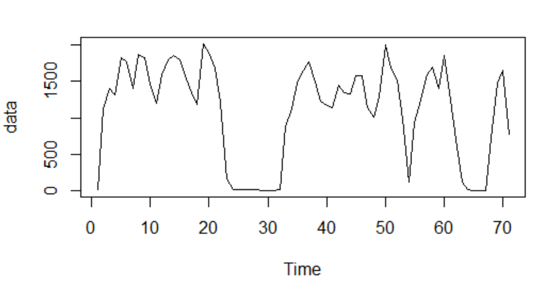
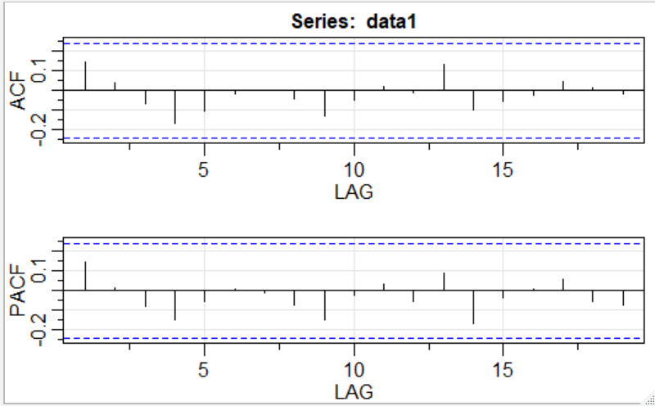
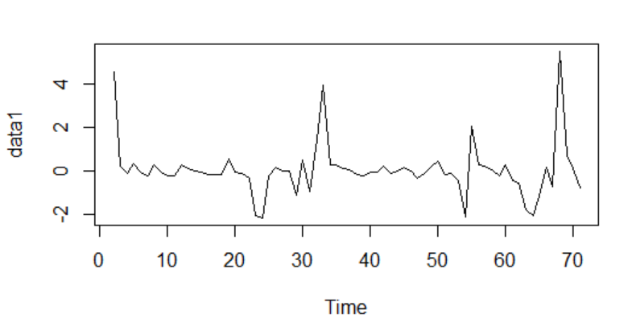
Number of new comments
Initial Time series plot
Variance and trend - removed
Model selected: ARIMA(1,1,0)

Slide 5
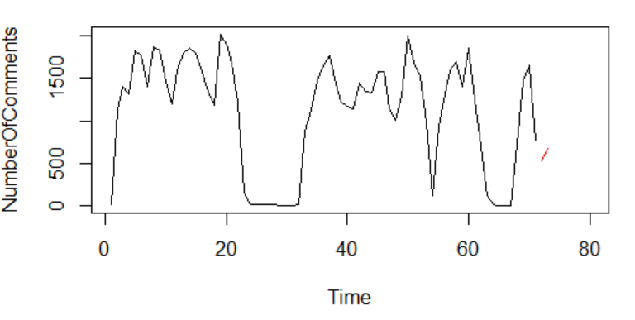
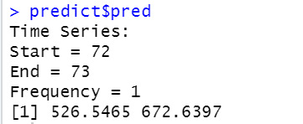
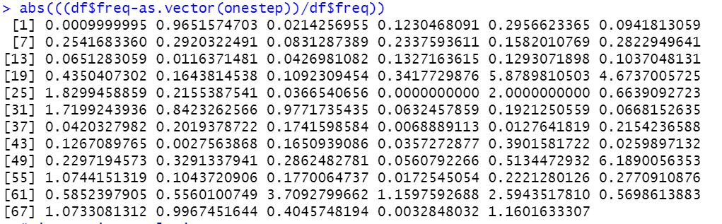
Number of new comments - Results
Prediction plot
Prediction values for number of articles between 2020-09-25 - 2020-09-26:
MAPE values for prediction:

Slide 6
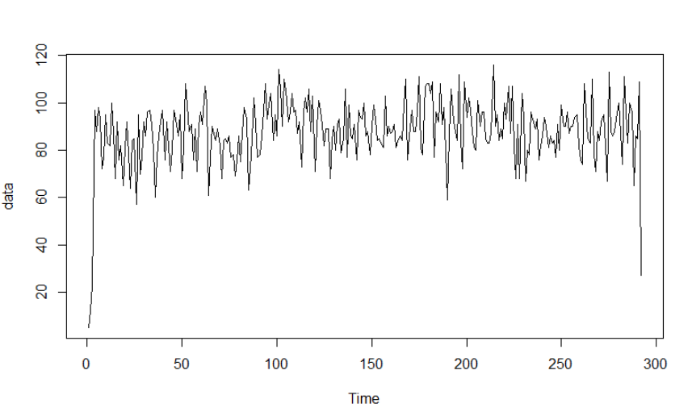
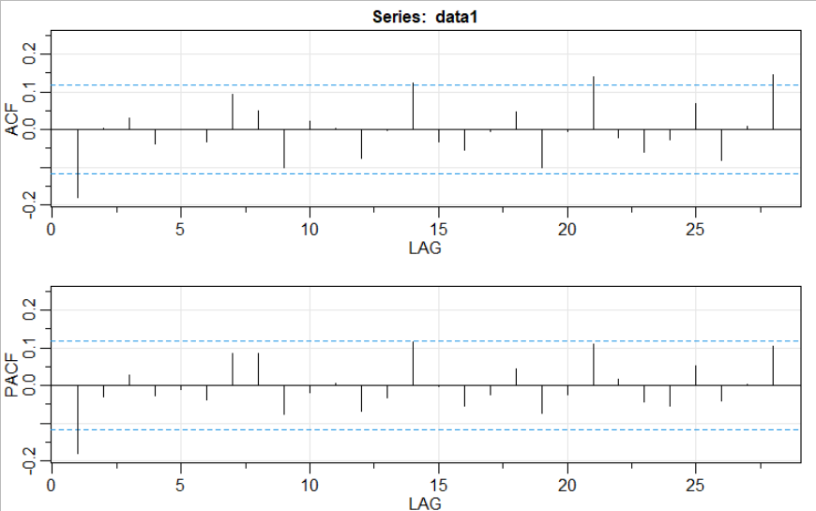
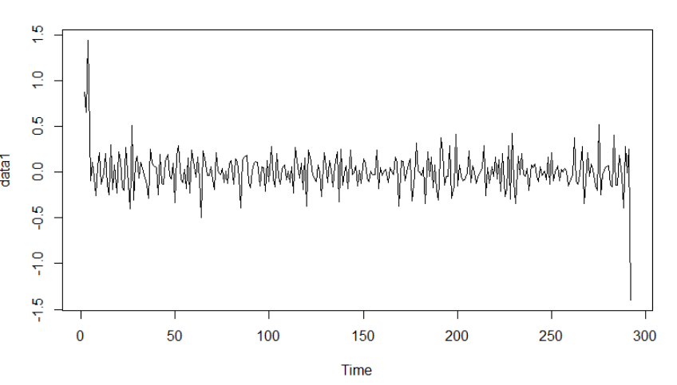
Number of new articles
Initial Time Series Plot:
ACF PACF Plots:
Variance & Trend - Removed:
Model selected: ARIMA(4,1,4)

Slide 7
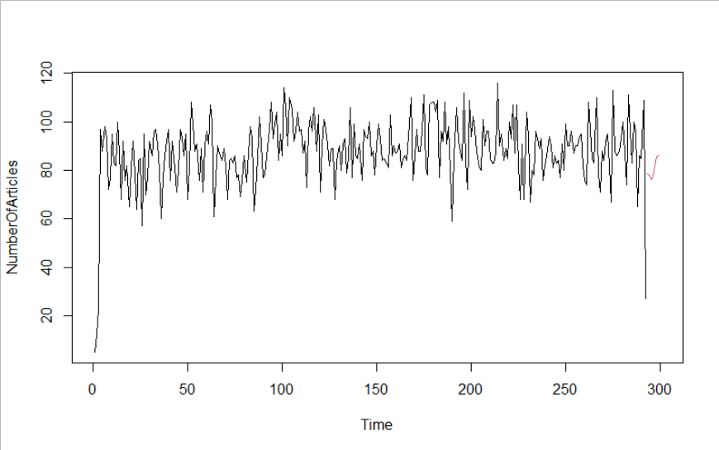
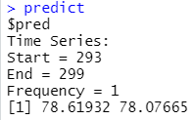
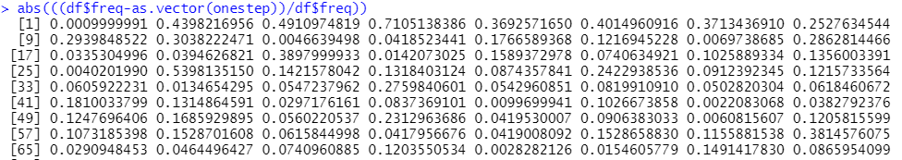
Number of new articles -Results
Prediction plot
Prediction values for number of articles between 2020-09-25 - 2020-09-26:
MAPE values for prediction:

Slide 8
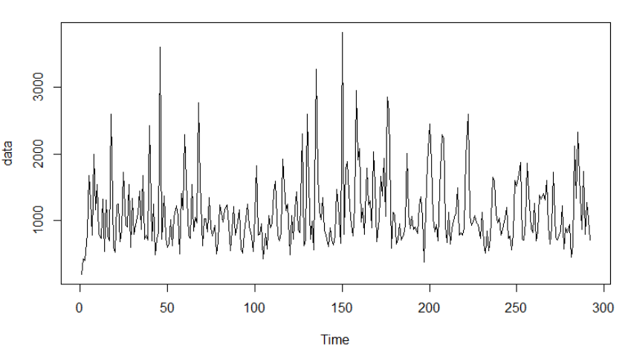
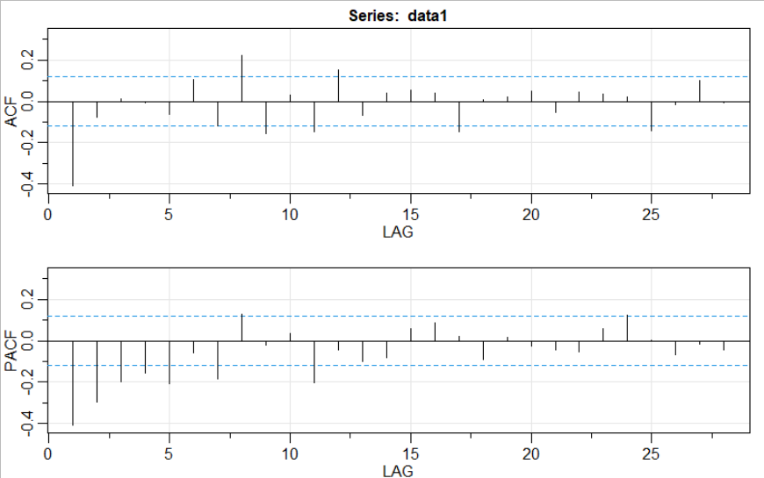
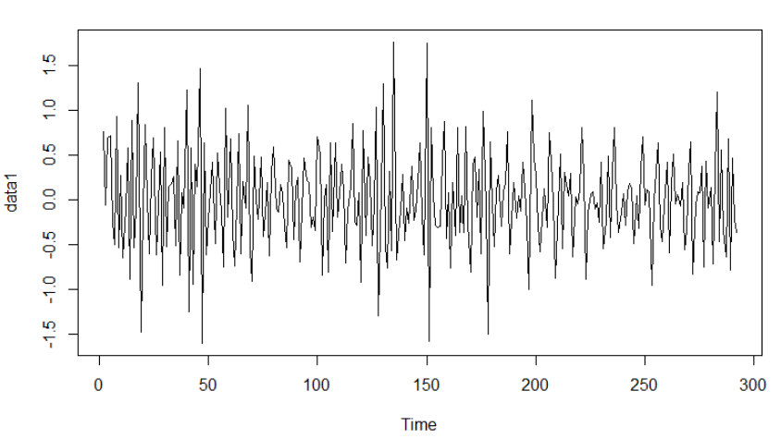
Highest number of points
Initial Time Series Plot:
Variance & Trend - Removed:
Model selected: ARIMA(1,1,1)

Slide 9
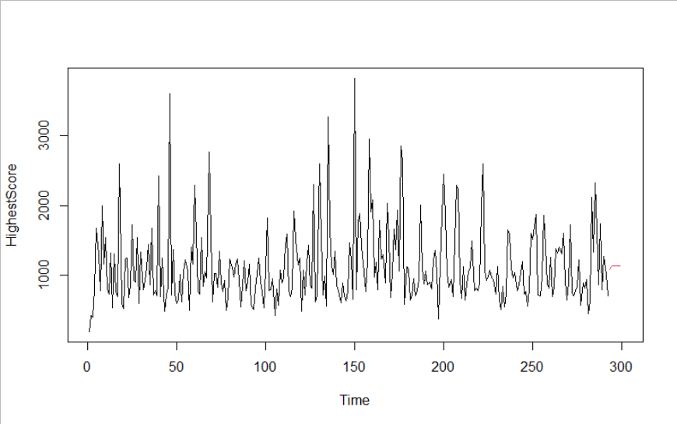
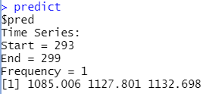
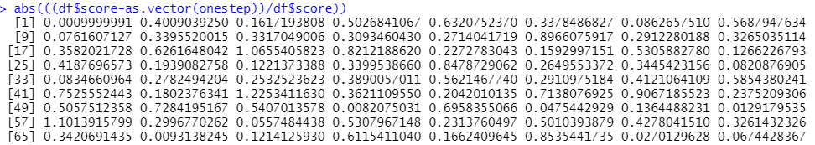
Highest number of points - Results
Prediction plot
Prediction values for highest no. of points at 2020-09-26 :
MAPE values for prediction:

Slide 10
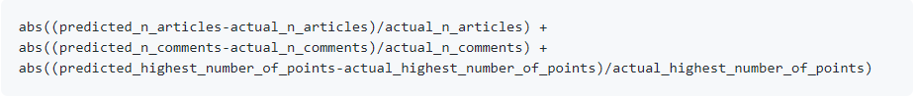
Final Results
Cost Function -
Adding the MAE values from above results:
0.6646217+0.111516+0.3741403
We have minimized the cost function and have obtained a combined loss of 1.15

